Slide 1
Post-Secondary Planning
Juniors Class of 2026
College Search
Part I
Notes:
Our presentation today is focused on the college search process. Our goal is to help you start the conversation about what is the best fit for you. We understand that many of you are at various stages of the college exploration process. The conversation now is very much geared toward students who are starting to think about their college options.
There is no need to take pictures of the slides, we will be sending this presentation to you. Please check your school emails.

Slide 2
AGENDA
Junior Year Timeline
College Search Process
Resources
Notes:
Every student is unique as is their readiness to enter the workforce, military, or post-secondary education.
While the topics that we are discussing focus on preparing for college, we also understand that the “University for All” philosophy is not the best fit for all. And while college planning may be a part of your family conversation, we want to stress the importance of the individual timeline and individual path.
We encourage everyone to proceed with the career and college search when it is appropriate and timely as you discuss post-secondary options consider the options that are right for you.

Slide 3
Junior year timeline
​ | Fall​ | Winter/Spring​ | Summer​
Testing​ | PSAT October. ​ AP Registration (for MP1 APs).​ | Take the SAT/ACT . AP Registration (for MP2-MP4 APs). | Register for fall SAT/ACT as needed.​ ASVAB for those considering military.​
Naviance​ | Research careers/majors in Naviance. Begin building list of colleges you're thinking about. Update resume. | College search process. ​ Update Resume. Continue to build list of colleges you're thinking about. | Student Complete “Counselor Recommendation Questionnaire” Survey.​ Update Resume.
College​ | Meet with College Admission Reps Visiting East.​ ​ | Attend Open Houses @ Colleges.​ Tour Colleges.​ College Fairs.​ View Online Virtual Tours.​ | Set up Campus Tours and Visit Schools of Interest.​ Begin College Applications.​
General​ | Create helpful accounts:​ E-Prep (Library)​ College Board/ACT​ Khan Academy and ACT Academy​ | Inquire about recommendations from 11th grade teachers.​ Save college essay and graded writing sample.​ Program Planning.​ | Write/Edit College Application Essay.​ Update Resume.​ ​
Notes:
These are general guidelines to help students focus on time-relevant tasks throughout the year.
Testing in particular may be on a more individual timeline depending on when the student completes certain levels of math (Algebra 2/Trig specifically). For those who took the PSAT in October, scores will be available sometime by mid-November in waves determined by CollegeBoard.
Students shouldn't feel pressure to take the SAT or ACT until they feel ready because not all students are at the same place in their curriculum. Generally speaking, though we see Juniors testing from January through June of the senior year.
Students should take advantage of the college exploration opportunities that are brought to them throughout the year. Specifically, College Rep Visits to East, virtual college fairs or college tours that are online, or by using the three “excused absences” allowed to attend college open houses or do campus tours.
We would really encourage that you take a look at the college representative visits list in Naviance if you have not done so already.

Slide 4
Admissions Considerations
Grades/GPA in college prep classes and rigor of course selection.
Keep in mind that senior mid-year grades are sent to all schools to which you apply.
Application Essay and Personal Statement.
Teacher and/or Counselor Recommendations.
Extracurricular Involvement & Leadership.
Standardized Test Scores.
*CBSD does not provide rank for admissions purposes.
Check out this article for more information on factors in the college decision!
Notes:
While there's no magic formula when it comes to college admission decisions, as a counselor, you can help your students understand what factors matter most to colleges.
Courses and Grades
A student's grades in college-preparatory classes remain the most significant factor in college admission decisions.
Personal statements and essays are both a measure of writing ability and a window into each student's background. Admission officers want to hear an original voice in the student's own words.
Recommendations from Counselors and Teachers
At many colleges, recommendations from counselors and/or teachers has become more important than ever. These recommendations should be highly specific, describing not just each student's love of learning, but the ways in which the students have demonstrated that they can:
Extracurricular Activities
Evidence of extracurricular activities is important to the admission process, and depth of involvement is more impressive than breadth. Students can achieve this if they:
Focus on a limited number of interests.
Document long-term involvement with organizations.
Highlight activities related to a major or career goal.
Show leadership skills and ability.
Test Scores
Standardized test scores has declined in importance at many colleges. Nevertheless, some colleges may require SAT or ACT scores.

Slide 5
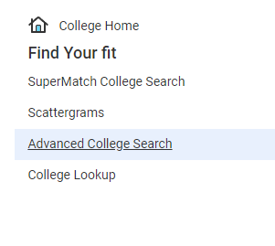
The College Search Find Your Fit...
Selection Criteria
2 or 4 year
Academics
Competitiveness/Admissions
Public vs private
Size
Cost
Coed vs single sex
Enrollment
Location & distance from home
Religious affiliation
Sports & Divisions & Intramurals
Diversity
Resources/Opportunities
Notes:
Finding FIT is the priority. Starting to research schools now to determine what types of schools are best for YOU is important to do this year so by spring and summer, you can determine which schools you'd like to visit. The more research you do now, the more you can narrow down a manageable list for yourself. Going into senior year with dozens of schools on your list or applying to more schools than you're truly interested in can make it more challenging to make decisions later. Not to mention, all those college application fees can be pricey at $50-70/each!
Feel free to make an appointment to see your counselor to review the list and see if we have any other suggestions.
2 or 4 year: Associates, Bachelors degrees
PUBLIC v PRIVATE: cost factors to consider but don't rule out more expensive schools until you search scholarship criteria. 4 PA State related universities vs. 14 State owned universities vs public universities as an out of state resident.
COST: We strongly encourage families to talk about financial contributions sooner than later.
Do they offer a college MAJOR that relates to your career field?
SIZE of school and faculty:student
DISTANCE from home for comfort and also the cost of travel
SPORTS/ACTIVITIES- School Spirit

Slide 6
A Valuable Resource
An online notebook to do research, track your progress, keep personal records...
Research
Colleges
Careers
Scholarships
Enrichment & Summer Programs
Analyze & Compare Data
Visit College Websites
Requesting Transcripts and Letters of Recommendation Senior Year
Notes:
NAVIANCE is an online resource where you can keep track of all your research, compare options, and monitor the records submission process when applying to schools.
College Search can be done on Naviance and students can “Favorite” colleges in their List of Colleges I’m Thinking About to help them organize their search. Students will have to complete the Advanced College Search for Success Plan this year.
Career Exploration (Success Plan)- multiple surveys to help students determine
Scholarships: national search databases, our CB East Scholarship List of private scholarships are posted in Naviance.
Typically the scholarships sent to us are for senior applicants, but occasionally we’ll see an essay contest come through for juniors. Juniors are encouraged to check out the scholarship list this year so they are aware of the criteria for the following year.
Come senior year, all records requests for transcripts and recommendations will be done through Naviance.

Slide 7
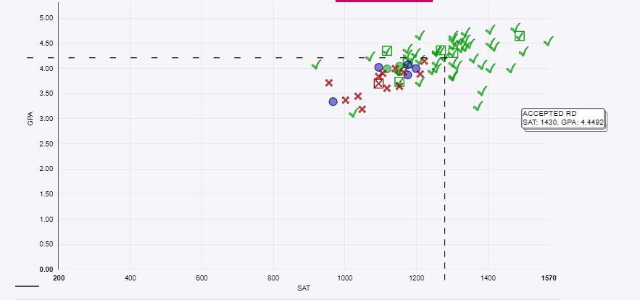
Research & Comparison Tools
Keep track of your research in one place.
Colleges I’m Thinking About
& Scatterplots
Notes:
Scattergram provides visual comparison to you and East applicant history.
Once you add schools to your Colleges I’m Thinking About list, you can find the scattergram for the college by going to “MORE”.
The Scattergrams include student decisions of former CB East students, so you are comparing your student to others who have been assessed based on our curriculum and culture.
Green means they were accepted, Red indicates denied decision. You are the little blue “person” icon based on your PSAT last year or SAT/ACT as soon as you take them with your Cumulative GPA.

Slide 8
Check out the Statistics
Notes:
Once you click on the College itself, you can find information about tuition; acceptance rates; admissions criteria; general information like size, locale, public/private, degrees offered; college overlaps (students that apply to this college also apply to these similar colleges", app deadlines, compare yourself to others from East who have applied...), faculty : student ratio; majors, student life etc.
Use these stats to guide your questions when you go on campus visits or meet with reps. How many graduate in 4 years? 5 years? What is your retention rate?
Can you identify a common thread that connects you to the colleges you are researching?
Look at admission requirements and let that also assist you with course selection for senior year.

Slide 9
Online College Search Tools: Ratings, Discussion Boards, Search Engines
College Board/Big Future
Common App/Explore Colleges
Cappex
Unigo
Niche
TheCollegeTour.com
College Confidential
College Navigator
HS Navigator
US News and World Report’s Best Colleges Report
The Princeton Review
Forbes Magazine’s America’s Top Colleges
Kiplinger’s Best College Values
Notes:
There are hundreds of search tools online that can help families broaden their search. Some online resources are based on data while others focus on student feedback and anecdotal information gathered from current students and alumni. This slide provides a variety of search engines that provide different information and perspectives. Some of these sites provide rankings while others provide search options and information about colleges and universities.
We urge students and families to investigate any website with a critical eye when using any online resource to help with your college search. These are all excellent tools to use as you are building your college list or can be useful to narrow down a list based on specific criteria that is important to you.

Slide 10
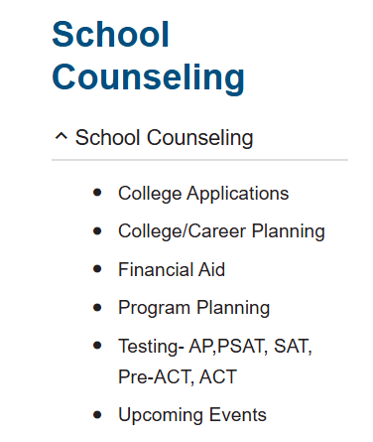
RESOURCES
School Counseling Webpage
Naviance- College and Military visits, Statistics, College Search tools, Virtual campus tours
School Counselor – Students should schedule individual appointments
College Rep Visits
Check your CBSD email!
Read updated from the weekly East Side Story!
ACT and College Board (SAT & PSAT) websites
Notes:
So many resources to guide you through the process…
Counseling Website- Presentations (College Planning, Financial Aid Night), Application Process documents
Access Naviance - is the college and career research tool we primarily use in CB. There is an immense amount of information for career exploration (see Success Plan surveys from sophomore and junior year) as well as college exploration tools to help start the search process all the way through the application process where students will request records and organize their records and recommendations.
Individual Appointments- We ask that students initiate appointments with us as needed, as often as they need, to ask questions about the process, your own testing timeline, advice on schools, etc. We are specifically asking that students try to see us in person. Meeting in person is more effective and gives us a chance to get to know the student much better. After all, some day soon we may need to write a letter of recommendation! Students can also stop in C 106 Counseling office to make an appointments.
College Representatives- Students can view when the college reps who will come to East through Naviance under the Colleges Link at the top of the page. The list is also posted on the LGI doors, and please stop in the LGI to meet with the college reps. The representatives that visit East are the same individuals who will be reading our student’s applications.
ACT/CollegeBoard Websites- Students register for SAT/ACT directly on the site (not at school). Find everything from admissions to financial aid and more on these sites- very helpful!
CBSD Email- If we send an email, it’s usually about something important so we really need students to check their student account minimally once per week. If not, they may miss timely and important information from us!

